Slide 1


CARDIOVASCULAR DISEASE PREDICTION
SAT 5165 – BIG DATA ANALYTICS
Rahul Vallapureddy, Vijaya Lakshmi Challagulla, Kalpana Danaboyina
4/26/2023

Slide 2
OUTLINE
Introduction
Motivation
Objective
Data Description
Data Preprocessing
Data Visualization
Methods
Results
Conclusion and Future Work
References
4/26/2023

Slide 3
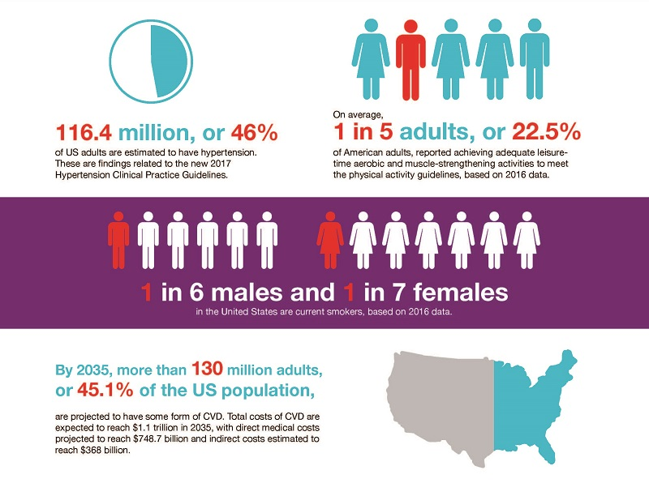
INTRODUCTION
Cardiovascular disease is the major factor of attention to medical research due to several risk factors such as blood pressure, diabetes, cholesterol, and many other factors.
4/26/2023

Slide 4
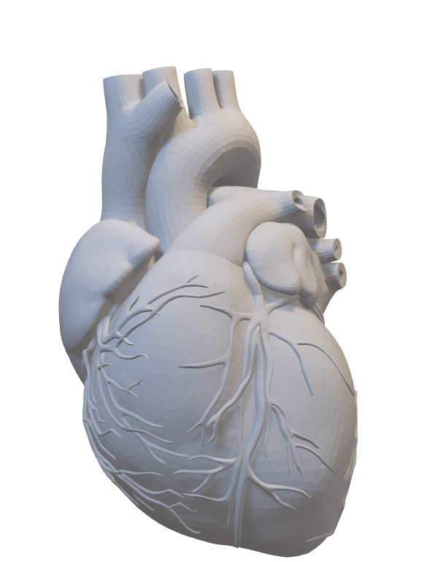
MOTIVATION
Implementation of machine learning technologies in healthcare has the potential to improve effectiveness while remaining cost-efficient.
Automated prediction of a patient’s cardiac health status can play a critical role in enhancing medical diagnosis and treatment
By analyzing the clinical parameters of patients, it is possible to make accurate predictions about the presence of heart disease.
4/26/2023

Slide 5
OBJECTIVE
Selecting risk factors
Output
Machine Learning models
To evaluate the risk of cardiovascular disease.
DT, NB, Logistic Regression
Age, Height, Weight, Gender, Systolic, Diastolic, Cholesterol, Glucose, Smoking, Alcohol activity, Physical activity
Cardiovascular disease prediction
4/26/2023

Slide 6
DATA DISCRIPTION
# | Column Name | Description
1. | Age | Age of the person in days
2. | Height | Height of the person in centimetres
3. | Weight | Weight of the person in kilograms
4. | Gender | Male and female
5. | ap_hi | Systolic blood pressure
6. | ap_lo | Diastolic blood pressure
7. | Cholesterol | 1: normal, 2:above normal, 3: well above normal
8. | Glucose | 1: normal, 2:above normal, 3: well above normal
9. | Smoking | Whether patient smokes or not
10. | Alcohol Activity | Consumption of alcohol
11. | Physical Activity | Presence of physical activity or no
The dataset contains 70,000 records of patient data.
It contains 11 attributes with the target variable describing the presence or absence of heart disease.
Input features are of three types –
Objective – containing descriptive information
Examination – containing the results of medical examination
Subjective – containing information given by the patients.
4/26/2023

Slide 7
DATA PREPROCESSING
Checked all columns in the data for null values, inconsistent data types, and formats.
To convert the given age from days to years, divided it by 365.
Applied percentile-based outlier detection to identify and remove any extreme values in the dataset.
Utilized body mass index as a comprehensive measure of an individual’s weight status, considering both their height and weight.
Computed Mean arterial pressure by incorporating both systolic and diastolic blood pressure.
Converted continuous data variables, such as age, BMI, and mean atrial pressure into numerical values.
Applied the get_dummies function to all variables, except for the output variable, to generate new binary columns for each unique value of the respective variable,
4/26/2023

Slide 8
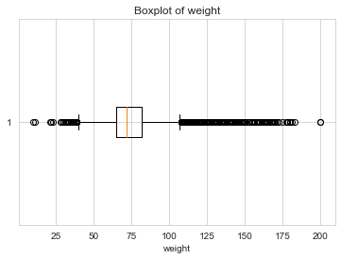
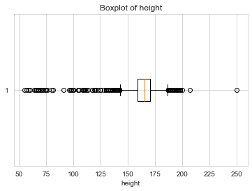
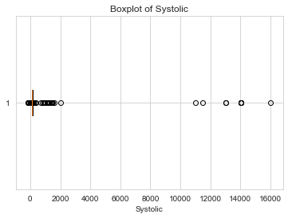
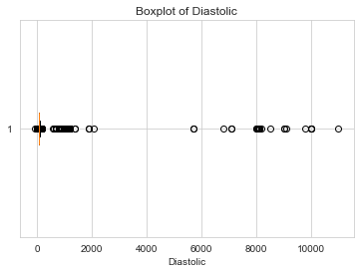
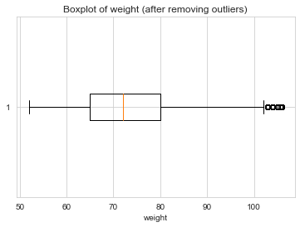
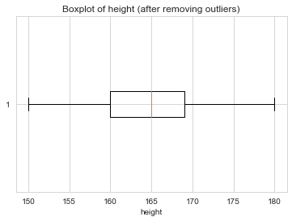
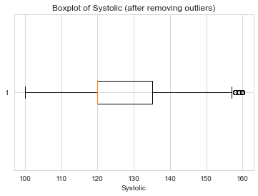
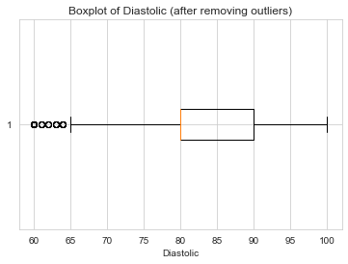
4/26/2023

Slide 9
DATA VISUALIZATION
Data visualization – to analyze complex data, identify patterns, and extract valuable insights.
Among many categories of data visualization, we used multi-dimensional.
Histograms were plotted to identify patterns in all variables.
Plotted stacked bar graphs to see the relationship between each variable and the output cardiovascular disease.
To analyze the correlation between variables and the output, a heat map was created.
4/26/2023

Slide 10
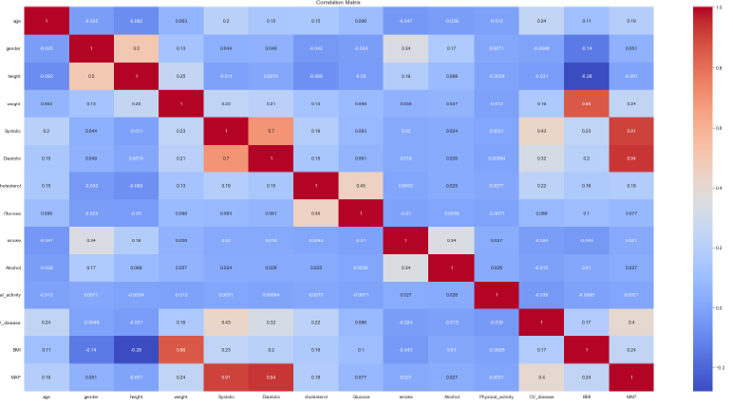
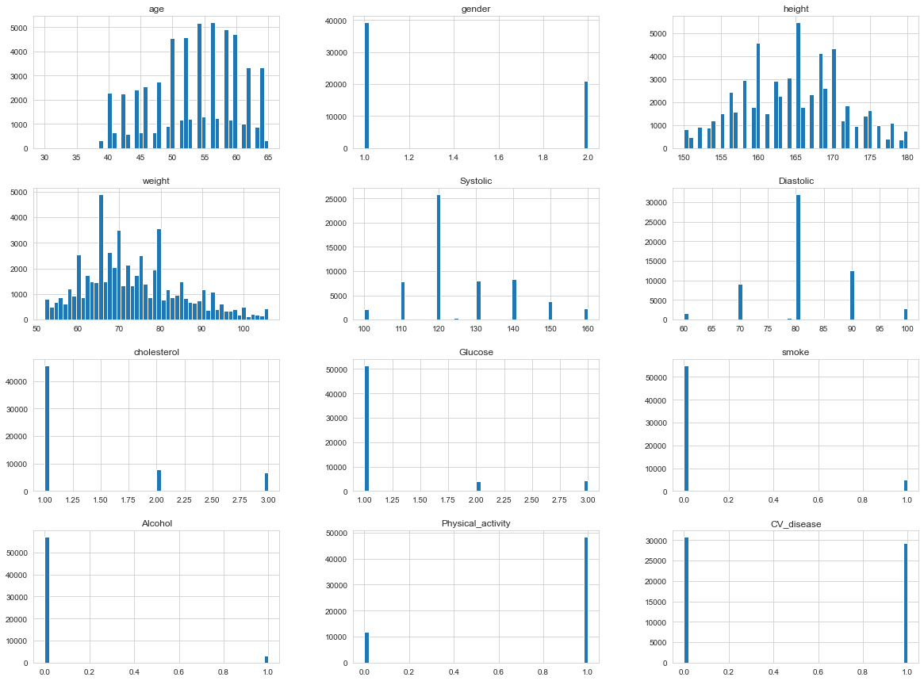

Slide 11
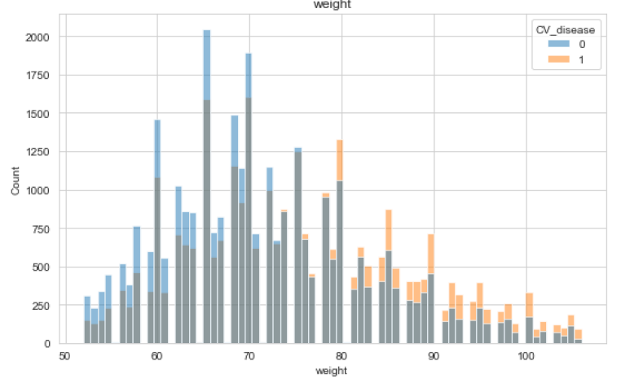
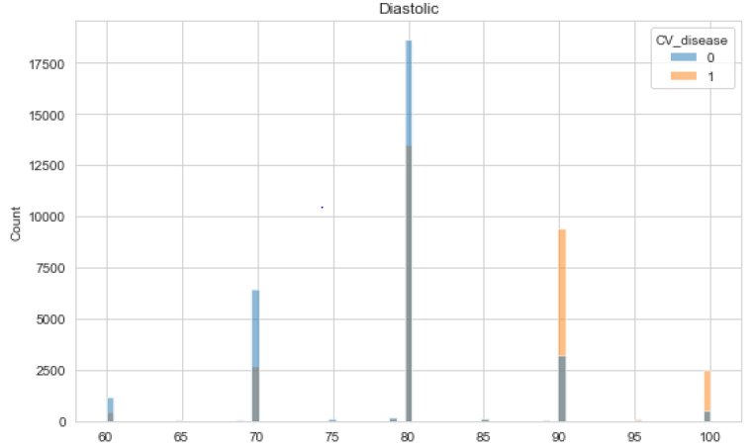
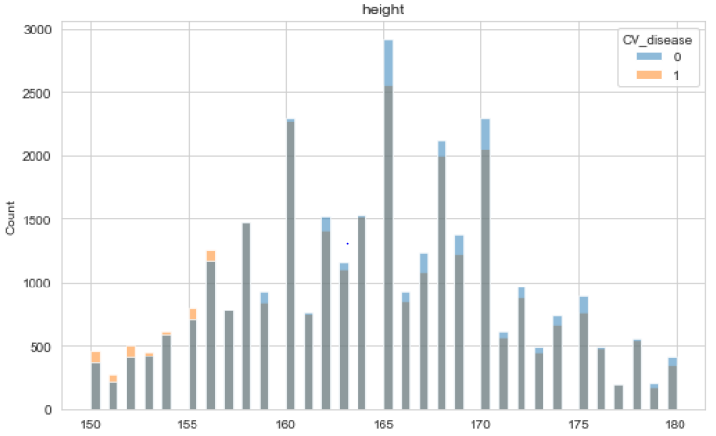
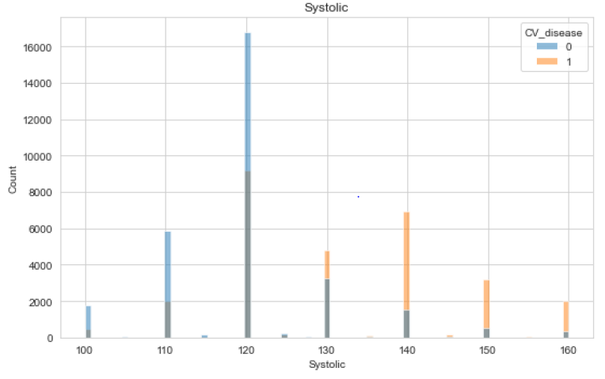

Slide 12
METHODS
Five machine learning algorithms were used:
Decision Tree (DT)
Naïve Bayes Classifier
Logistic Regression (LR)
K-fold cross-validation was performed
Hyperparameter tuning was performed to check for the optimal parameters of machine learning models.
Standard scalar is a technique used in machine learning to transform features to have a mean of 0 and a standard deviation of 1, making them comparable and easier to analyze. It is commonly used in algorithms that are sensitive to the scale of the input features.
4/26/2023

Slide 13
METHODS
Decision Tree (DT)-creates a tree based on which it Assigns the class value to each data point and can vary based on the number of features
Logistic Regression (LR)- mainly used for classification tasks where the goal is to predict the probability that an instance of belonging to a given class.
Naive Bayes Classifier -Naive Bayes Classifier is a probabilistic algorithm for classification tasks. It predicts the probability of a given observation belonging to a particular class based on the conditional probabilities of the features in that observation.
4/26/2023

Slide 14
METHOD
DATA COLLECTION AND UNDERSTANDING
PRE PROCESSING
EXPLORATORY ANALYSIS
INTERPRETATION
Algorithms:
DT
RF
LR
INPUT
APPLY ALGORITHAM
OUTPUT
4/26/2023

Slide 15


METHODS
Precision = $\frac{True Positive}{True Positive+False Positive}$
Predicted/Classified
 | Negative | Positive
Negative | True Negative | False Positive
Positive | False Negative | True Positive
Recall = $\frac{True Positive}{True Positive+False Negative}$
F1 Score = 2 x $\frac{Precision ∗Recall}{Precision+Recall}$
4/26/2023

Slide 16
RESULTS
Statistics for machine learning algorithms.
Model | Accuracy | Precision | Recall | F1-Score
Decision Tree (DT) | 73 | 0.72 | 0.76 | 0.74
Naive Bayes classifier | 59.35 | 0.56 | 0.87 | 0.68
Logistic Regression (LR) | 72 | 0.70 | 0.76 | 0.73
4/26/2023

Slide 17
CONCLUSION
Among all Logistic Regression classifiers performed better with better accuracy in predicting cardiovascular diseases.
Age, weight, systolic, and diastolic are the most related clinical features for cardiovascular diseases
Hyperparameter tuning really helped to get improved the accuracy
We may investigate deep learning algorithms to see better results
4/26/2023

Slide 18
REFERENCES
https://www.mathworks.com/discovery/machine-learning-models.html
https://compgenomr.github.io/book/predicting-continuous-variables-regression-with-machine-learning.htm
https://towardsdatascience.com/the-beginners-guide-to-selecting-machine-learning-predictive-models-in-python-f2eb594e4ddc
4/26/2023

Slide 19

Questions?
4/26/2023

